Slide 1
Segmentation, Labelling
1

Slide 2
Segmentation
Image Segmentation
The process of partitioning a digital image into multiple segments(sets of pixels known as image objects)
The goal is to simplify or change the representation of an image into something more meaningful to analyze
Used to locate objects and boundaries in images
It assigns label to every pixel in an image such that pixels with same labels share certain characteristics
2

Slide 3
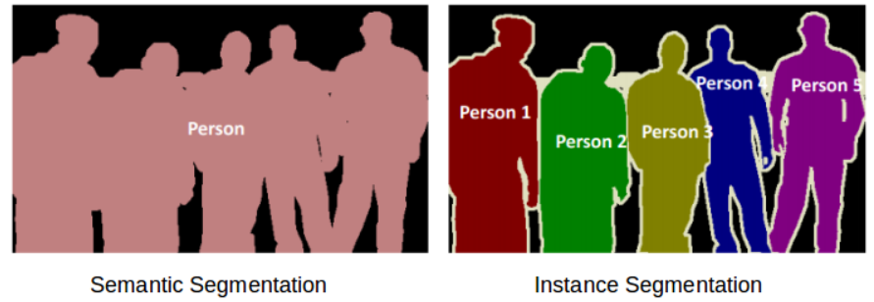
Groups of image Segmentation
Semantic segmentation
An approach for detecting, for every pixel, belonging to the class of the object
Instance segmentation
An approach that identifies, for every pixel, a belonging instance of the object
It detects each distinct object of interest in the image
3

Slide 4
Methods of image Segmentation
Thresholding
Clustering method
Edge Detection
Motion and interactive segmentation
Histogram-based methods
4

Slide 5
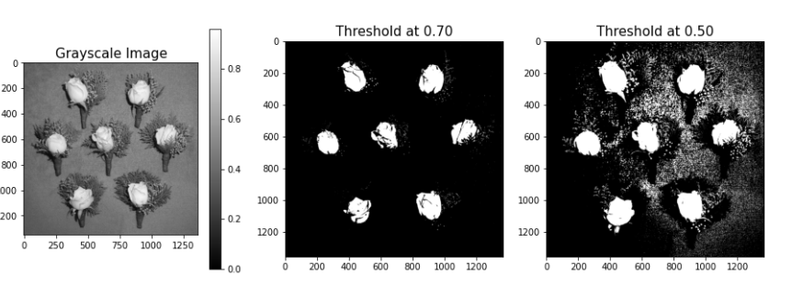
Thresholding
The simplest method of image segmentation.
This method is based on a clip-level (or a threshold value) to turn a gray-scale image into a binary image.
The key of this method is to select the threshold value (or values when multiple-levels are selected).
5

Slide 6
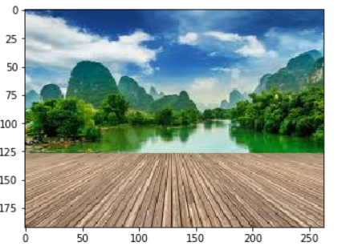
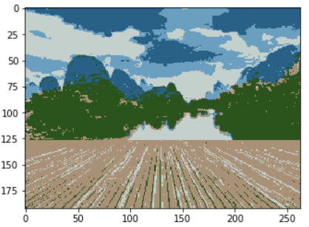
Clustering Method
The K-means algorithm is an iterative technique that is used to partition an image into K clusters.
The distance is the squared or absolute difference between a pixel and a cluster center.
The difference is typically based on pixel color, intensity, texture, and location, or a weighted combination of these factors.
K can be selected manually, randomly, or by a heuristic. This algorithm is guaranteed to converge, but it may not return the optimal solution.
The quality of the solution depends on the initial set of clusters and the value of K
6

Slide 7
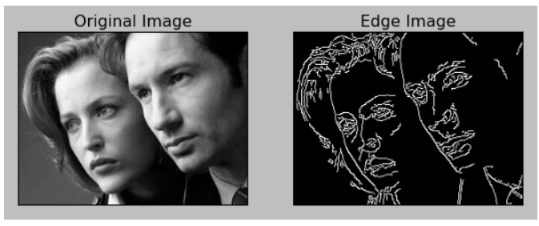
Edge Detection
Region boundaries and edges are closely related, since there is often a sharp adjustment in intensity at the region boundaries.
Edge detection techniques have therefore been used as the base of another segmentation technique.
The edges identified by edge detection are often disconnected.
To segment an object from an image however, one needs closed region boundaries.
The desired edges are the boundaries between such objects.
7

Slide 8
Homework
Read about other segmentation methods
Implement some of these methods
8

Slide 9
Labelling
9

Slide 10
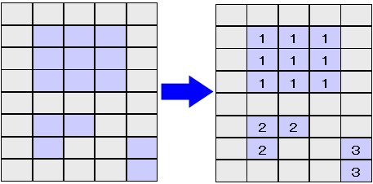
Labeling
Labeling in Image processing
Assigning a label(number) to each object in the image

Slide 11


Labeling
Original image
Labeled Result
Indicates that each object in the image is a different object

Slide 12
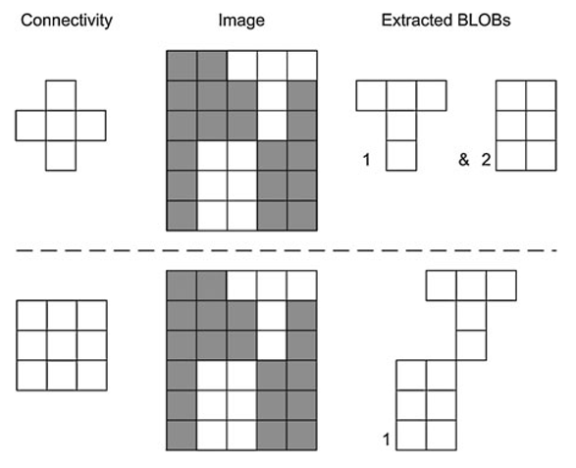
Labeling
Binarized image
4 Directions
8 Directions

Slide 13
Labeling
Labeling Algorithms
Recursive Algorithm-flood fill(=grass fire)
2-pass Algorithm

Slide 14
Labeling
Flood fill(grass fire) Algorithm
The algorithm takes three parameters: a start node, a target color and a replacement color
The algorithm looks for all nodes in the array that are connected to the start node by a path of the target color
It then changes them into the replacement color
Recursive flood fill with 4 directions
Recursive flood fill with 8 directions

Slide 15
2-pass Algorithm
The algorithm makes a two pass over the image.
The first pass to assign temporary labels and record equivalences and the second pass to replace each temporary label by the smallest label of its equivalence class

Slide 16
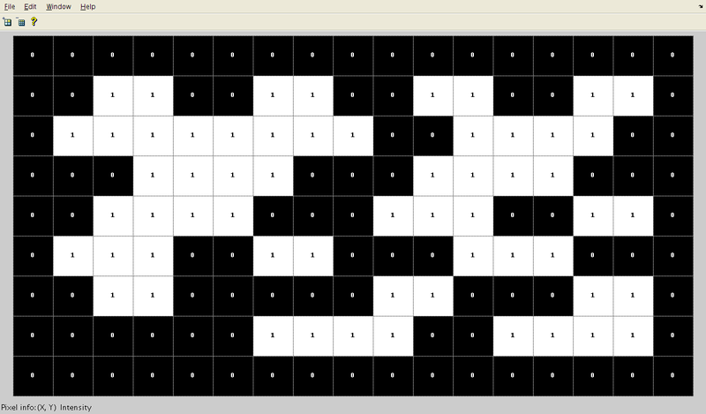
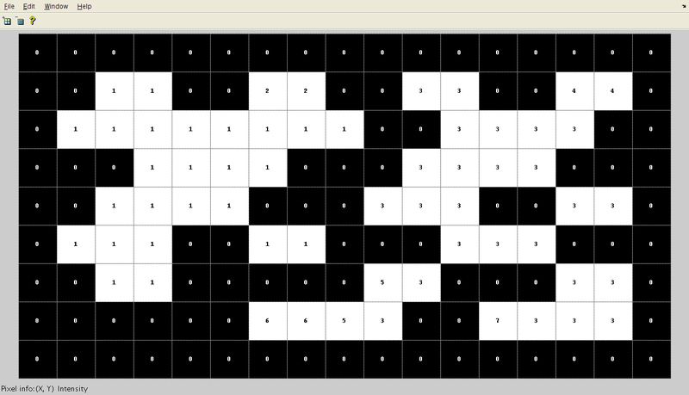
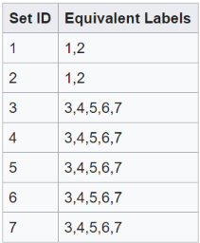
2-pass Algorithm
After the first pass, these labels are generated
The array from which connected regions are to be extracted (8-connectivity based)
The label equivalence relationships generated

Slide 17
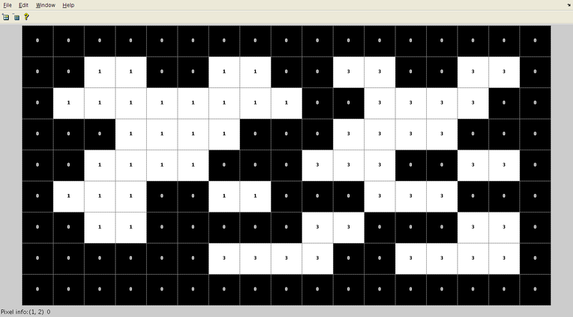
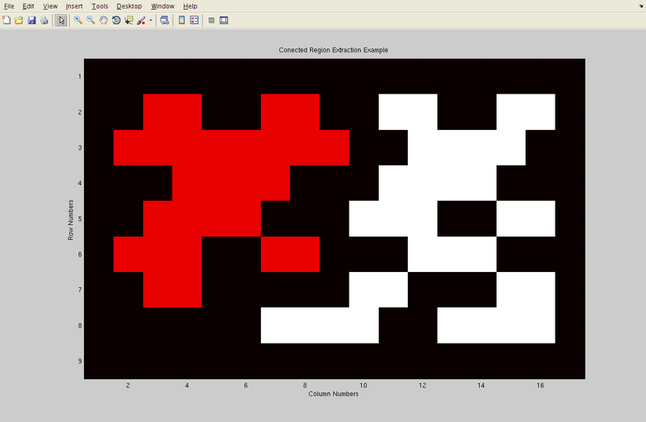
2-pass Algorithm
Array generated after the merging of labels is carried out
Final result in color to clearly see two different regions that have been found in the array.

Slide 18
Homework
Implementing a labeling algorithm(recursive-way, 2-pass).
-Pick a random image and apply labelling to it.

Slide 19
Thank You
19

